Slide 1
Font and Text Properties
Font Properties | Font Sizes | Text Properties
Notes:
Welcome to out lecture on CSS font and text properties. In this lecture we will go through common properties like font properties, Font Sizes, and text properties. Let’s start our lecture.

Slide 2
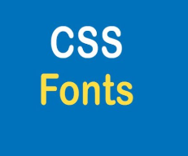
Font Properties
Many CSS properties control the font properties for displaying text. CSS font properties include:
The font-family property specifies the font family, such as "Times New Roman" or serif.
The font-size property changes the font size, such as 120%, small, or 12px.
The font-weight property specifies the font weight, such as normal or bold.
Notes:
CSS font properties control how text appears on a webpage. The font-family property sets the typeface, such as Times New Roman or serif. The font-size property adjusts text size using values like percentages, small, or pixels (e.g., 120 percent or 12px). The font-weight property determines text boldness, with options like normal, bold, or numerical values for fine control. These properties enhance text styling.

Slide 3
Font Properties
The font-style property changes the text style, such as normal, italic, or oblique.
The font-variant property specifies the variant of the text, such as normal or small-caps.
The font property is shorthand for setting several font properties at the same time. Ex: font: italic 12pt Georgia, serif;
Notes:
CSS font properties enhance text styling. The font-style property changes the style of text to normal, italic, or oblique. The font-variant property controls text variants like normal or small-caps. The font property is a shorthand for combining multiple font settings, such as style, size, and family, in a single declaration. Example: font: italic 12pt Georgia, serif. These properties improve text design.

Slide 4
Font Properties
The font-family property contains a list of fonts specified as a family name or a generic family separated by commas.
Family name: Specifies a specific font (e.g., "Times New Roman", Arial). Use quotes for names with spaces.
Generic family: Groups fonts by style (e.g., serif, sans-serif). Serif fonts, like Times New Roman, have small strokes at the ends of letters.
Notes:
The font family property specifies fonts for text. A family name defines a specific font, like Times New Roman or Arial. Use quotes for names with spaces. A generic family groups fonts by style, such as serif or sans-serif. Serif fonts, like Times New Roman, include small strokes at the ends of letters. Listing multiple font options ensures a fallback font is used if the first is unavailable.

Slide 5
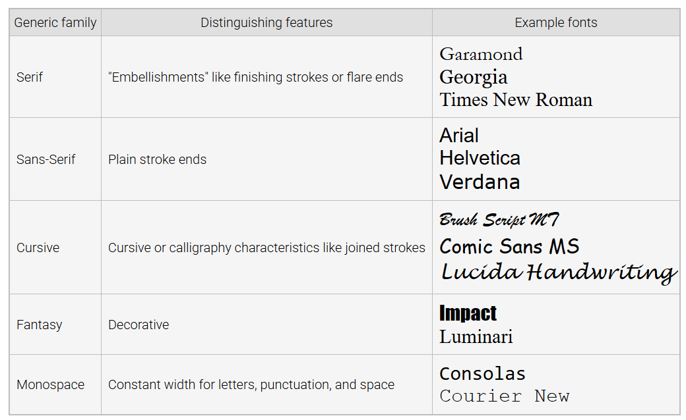
Generic Font Family Names
Notes:
This table shows generic font families group fonts based on common characteristics. Serif fonts, like Times New Roman, have finishing strokes or flared ends. Sans-serif fonts, such as Arial, have plain stroke ends. Cursive fonts mimic handwriting with joined strokes. Fantasy fonts are decorative, like Impact. Monospace fonts, like Courier New, use consistent letter widths. These categories help define text style effectively.

Slide 6
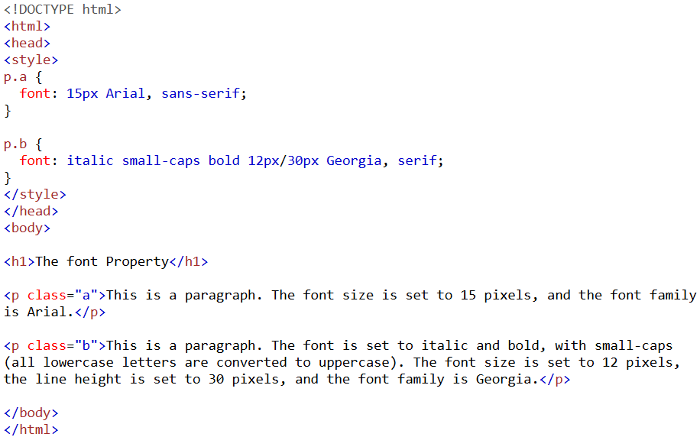
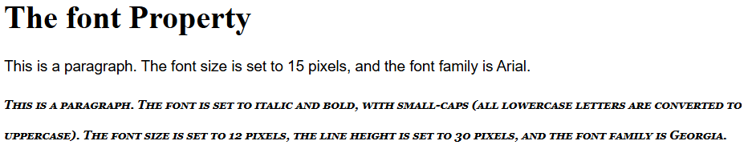
Example
Notes:
This example demonstrates the font property. In the first paragraph, the font size is 15px, and the font family is Arial with sans-serif as a fallback. In the second paragraph, the font combines italic, bold, and small-caps. It uses a font size of 12px, a line height of 30px, and the Georgia font family with serif as a fallback. The font property allows compact and versatile text styling.

Slide 7

Font Sizes
Font size can use predefined names: xx-small to xx-large (default is medium).
Relative size names: smaller or larger, adjust size relative to the parent element.
Can also use absolute or relative units (e.g., px, em, rem) for precise sizing.
Font sizes can of absolute size and relative size. Let’s discuss them in the next slides.
Notes:
Now move on to font sizes in CSS that can be set using predefined names, like small to large, with medium as the default. Relative size names, such as smaller or larger, adjust the size relative to the parent element. For precision, absolute or relative units like PX, EM, or REM can be used. Font sizes can be classified into absolute or relative categories, let’s discuss them in the next slides.

Slide 8
Font Sizes
An absolute size is a size that is fixed and independent of other CSS sizes. Absolute size units include:
cm - centimeters
mm - millimeters
in - inches
px - pixels (1px = 1/96in)
pt - points (1pt = 1/72in)
pc - pica (1pc = 12pt)
Notes:
Absolute font sizes are fixed and not influenced by other CSS sizes. Common absolute size units include cm for centimeters, mm for millimeters, and in for inches. Pixels are widely used, where 1 pixel equals 1 by 96 of an inch. Points represent 1 by 72 of an inch, and pica equals 12 points. These units provide precise control, making them ideal for fixed layouts and print styles.

Slide 9

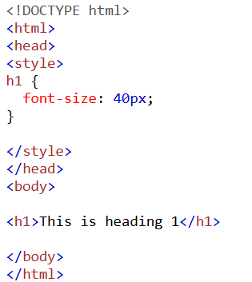
Absolute Font Size Example
Notes:
This example demonstrates an absolute font size. The H1 element is styled with a font size of 40 pixel, meaning the text will always appear at this fixed size regardless of the parent or root element. Absolute font sizes, such as pixel, centimeter, or inch, are ideal for creating consistent designs where text dimensions need to remain unchanged across different devices or screen settings.

Slide 10
Font Sizes
A relative size is a size that is relative to another size. Some common relative size units include:
em: Relative to the element's font size (e.g., 2em = 2 × current size).
rem: Relative to the root element's font size (e.g., 1.5rem = 1.5 × <html> size).
vw: 1% of the viewport's width (e.g., 10vw = 10% of browser width).
vh: 1% of the viewport's height (e.g., 5vh = 5% of browser height).
%: Percentage of the element's font size (e.g., 120% = 20% larger).
Notes:
Relative font sizes adjust based on another size. The EM unit is relative to the element's font size like 2 EM equal to 2 times the current size. The REM unit is relative to the root element's font size like 1.5 REM equal to 1.5 times the root size. VW and VH units are percentages of the viewport's width and height. Percentages scale text relative to the parent size like 120 percent equal to 20 percent larger.

Slide 11
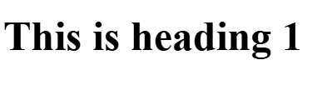
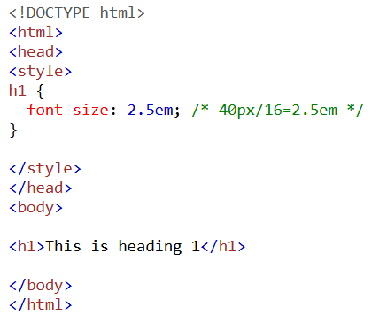
Relative Font Size Example
Notes:
This example shows a relative font size using the element EM unit. The H1 element is styled with a font size of 2.5 EM, which is 2.5 times the parent or default font size. If the default font size is 16 PX, the resulting size becomes 40 PX. Relative font sizes like EM allow flexible scaling based on the context, making them ideal for responsive designs and maintaining consistency across varying screen sizes.

Slide 12
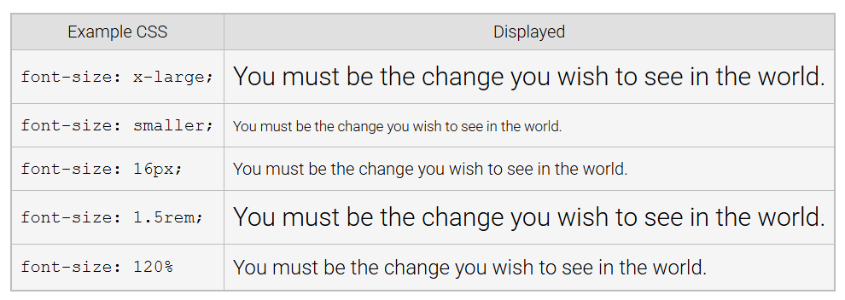
Example of Font Sizes
Notes:
This table demonstrates various ways to define font sizes in CSS. Using x large sets a predefined size. The smaller keyword reduces the size relative to the parent. Absolute sizes like 16 PX specify an exact size. The 1.5 REM value scales the font relative to the root element's size. Using 120 percent adjusts the font size relative to the parent. These methods provide flexibility for text styling.

Slide 13
Text Properties
Some common CSS text properties:
text-align: Aligns text horizontally (e.g., left, right, center, justify).
text-decoration: Adds or removes decorations (e.g., underline, overline, none).
text-transform: Changes letter case (e.g., uppercase, lowercase, capitalize).
text-indent: Sets the indentation for the first line of text.
Notes:
Finally, we will discuss CSS text properties that control the appearance of text. The text align property aligns text horizontally, with options like left, right, center, and justify. The text decoration property adds or removes styles like underline, overline, or none. The text transform property changes case to uppercase, lowercase, or capitalize. The text indent property sets the indentation for the first line of text.

Slide 14
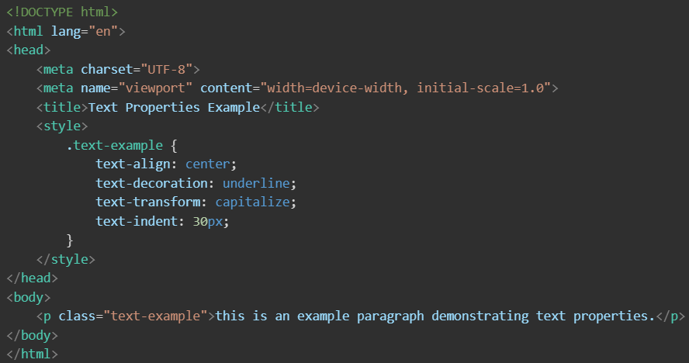
Text Alignment Example
This Is An Example Paragraph Demonstrating Text Properties.
Notes:
This example demonstrates CSS text properties. The paragraph uses text align center to center align the text, text decoration underline to underline it, text transform capitalize to capitalize the first letter of each word, and text indent 30 PX to indent the first line. These properties combine to enhance the text's appearance and improve readability, making it visually appealing and well-structured.

Slide 15
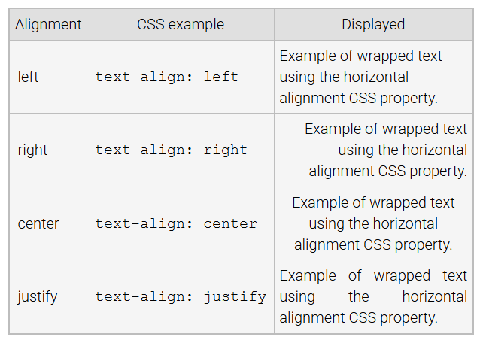
Text Alignment Example
Notes:
This table demonstrates the text align property. Left aligns text to the left margin, the default for most content. Right aligns text to the right margin. Center places the text in the middle of its container, while justify distributes text evenly, aligning it to both left and right margins. These options allow precise control over text alignment for improved readability and layout design. Thanks for watching the lecture.

